Slide 1
Quiz
JAD stands for???
RAD stands for ???

Slide 2
https://www.youtube.com/watch?v=HizIOlMphhs&t=2s

Slide 3

systems analysis phase
To understand the proposed project, ensure that it will support business requirements, and build a solid foundation for system development, by using models and other documentation tools to visualize and describe the proposed system.

Slide 4
Read Doa
رَبَّنَا ذِدْنَا عِلْمًا وَرْزُقْنَا فَهْمًا وَالْحِكْمَةً
وَاجْعَلْنَا مِنَ الصَّا لِحِيْنَ
“Ya Allah, grant us the useful knowledge, the sustenance to understand it, the wisdom, and make us become sholeh people”

Slide 5
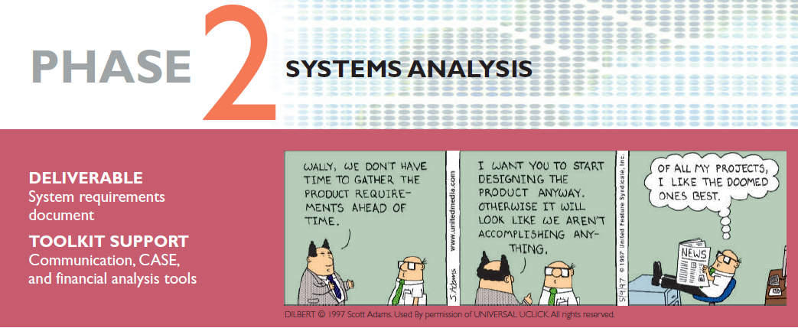
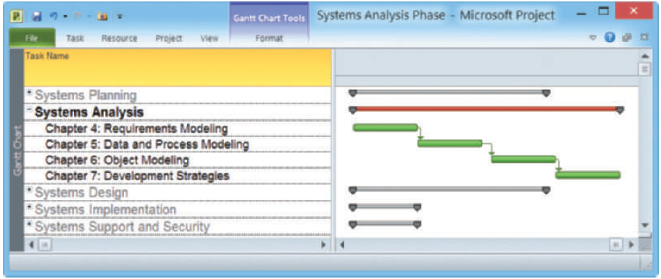

Systems Analysis and Design, 11th Edition
Scott Tilley and Harry Rosenblatt

Slide 6
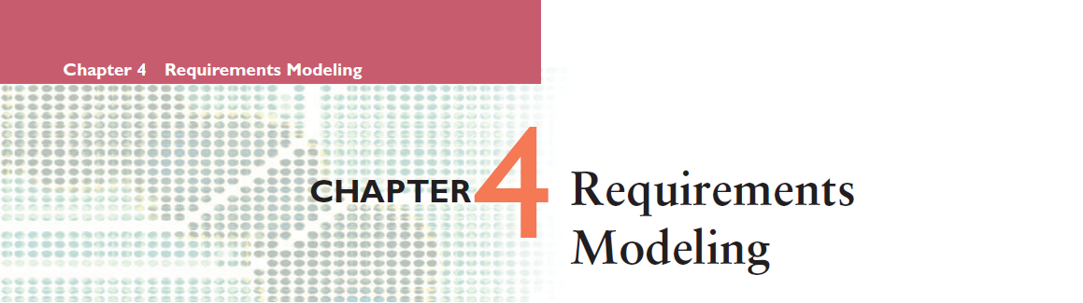


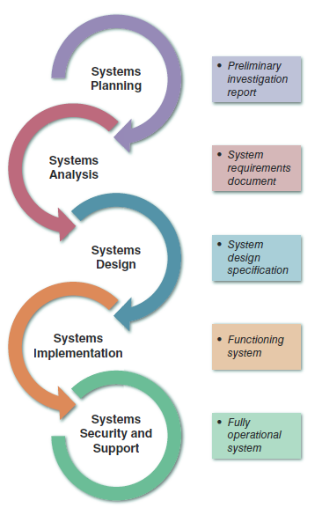
Systems analysis is the second of five phases in the systems development life cycle (SDLC)
Will use requirements modeling, data and process modeling, and object modeling techniques to represent the new system
Will consider various development strategies for the new system, and plan for the transition to systems design tasks

Slide 7
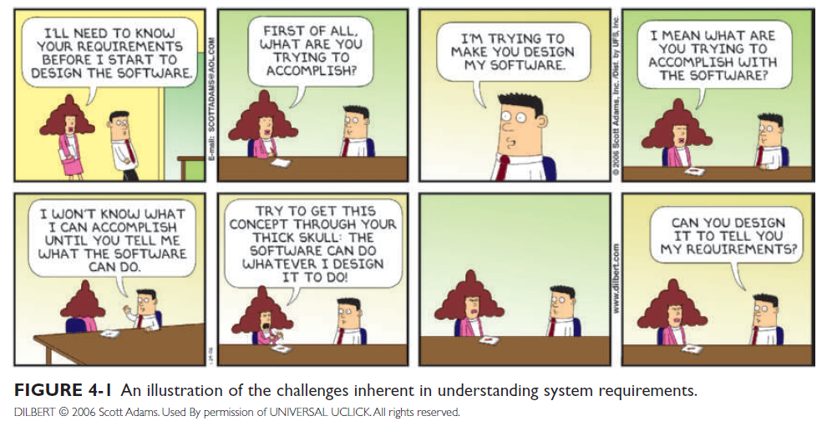
The Challenge
in understanding
system requirements

Slide 8
Chapter Objectives
Describe systems analysis phase activities and the end product of the systems analysis phase
Explain Joint Application Development (JAD), Rapid Application Development (RAD), and Agile methods
Understand how systems analysts use a Functional Decomposition Diagram (FDD)
Describe the Unified Modeling Language (UML) and explain use case diagrams and sequence diagrams
List and describe system requirements, including outputs, inputs, processes, performance, and controls
Explain the concept of scalability

Slide 9
Chapter Objectives
Use fact-finding techniques, including interviews, documentation review, observation, questionnaires, sampling, and research
Define total cost of ownership (TCO)
Conduct a successful interview
Develop effective documentation methods to use during systems development

Slide 10
Introduction
This chapter describes requirements modeling techniques and team-based methods that systems analysts use to visualize and document new systems
The chapter then discusses system requirements and fact-finding techniques, which include interviewing, documentation review, observation, surveys and questionnaires, sampling, and research

Slide 11
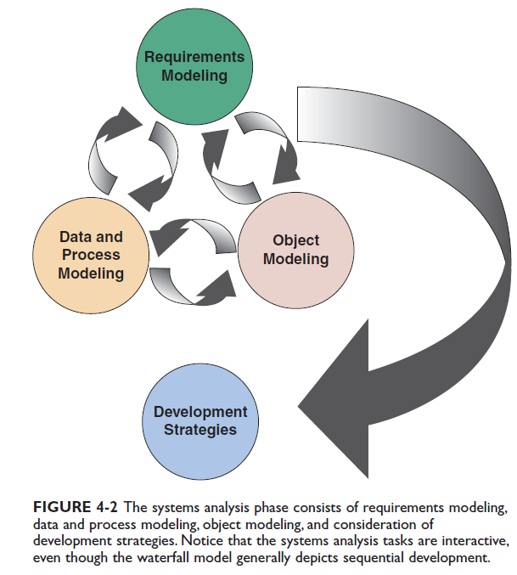
Systems Analysis Phase Overview
Interaction among the three modeling tasks:
  requirements modeling,
  data and process modeling,
  and object modeling

Slide 12
Systems Analysis Phase Overview
Requirements modeling
  describes requirements modeling, which involves fact-finding to describe the current system and identification of the requirements for the new system, such as:
    Output refers to electronic or printed information produced by the system.
    Input refers to necessary data that enters the system, either manually or in an automated manner.
    Process refers to the logical rules that are applied to transform the data into meaningful information.
    Performance refers to system characteristics, such as speed, volume, capacity, availability, and reliability.
    Security refers to hardware, software, and procedural controls that safeguard and protect the system and its data from internal or external threats.

Slide 13
Systems Analysis Phase Overview
Data and process modeling
  modeling process by showing how to represent graphically system data and processes using traditional structured analysis techniques.
  As described in Chapter 1, structured analysis identifies the data flowing into a process, the business rules that transform the data, and the resulting output data flow.
Object Modeling
  structured analysis treats processes and data as separate components, object-oriented (O-O) analysis combines data and the processes that act on the data into things called objects.
  These objects represent actual people, things, transactions, and events that affect the system.
During the system development process, analysts often use both modeling methods to gain as much information as possible.

Slide 14
Systems Analysis Phase Overview
Development Strategies
  There various development options within the transition of the systems design phase of the SDLC.
  As described in Chapter 1, structured analysis identifies the data flowing into a process, the business rules that transform the data, and the resulting output data flow.

Slide 15
Systems Analysis Phase Overview
Systems Analysis Skills
  Analytical skills
  Interpersonal skills
Team-Oriented Methods and Techniques
  Joint application development (JAD)
  Rapid application development (RAD)
  Agile methods

Slide 16
Joint Application Development (JAD)
User Involvement
  Users have a vital stake in an information system and they should participate fully
  Successful systems must be user-oriented, and users need to be involved
  One popular strategy for user involvement is a JAD team approach

Slide 17
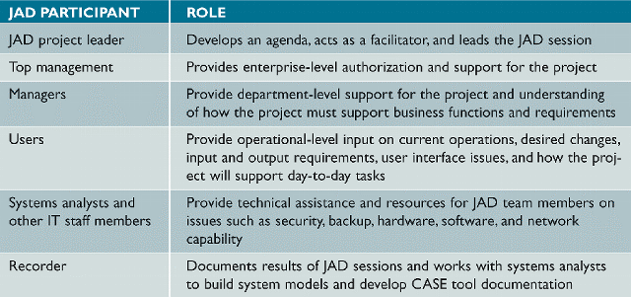
Joint Application Development (JAD)
JAD Participants and Roles

Slide 18
Joint Application Development (JAD)
JAD Advantages and Disadvantages
  More expensive and can be cumbersome if the group is too large relative to the size of the project
  Allows key users to participate effectively
  When properly used, JAD can result in a more accurate statement of system requirements, a better understanding of common goals, and a stronger commitment to the success of the new system

Slide 19
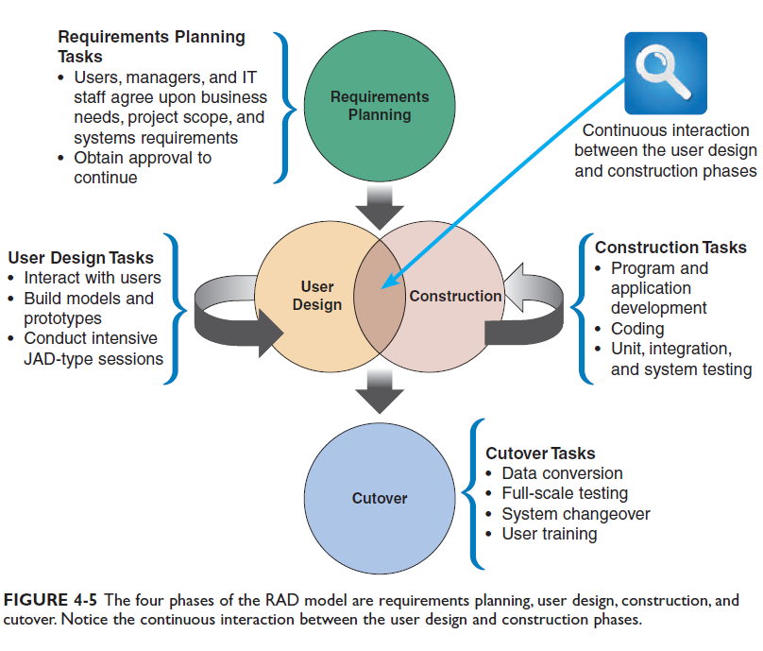
Rapid Application Development (RAD)
The RAD model consists of four phases.

Slide 20
Rapid Application Development (RAD)
RAD Objectives
  To cut development time and expense by involving the users in every phase of systems development
  Successful RAD team must have IT resources, skills, and management support
  Helps a development team design a system that requires a highly interactive or complex user interface

Slide 21
Rapid Application Development (RAD)
RAD Advantages and Disadvantages
  Systems can be developed more quickly with significant cost savings
  RAD stresses the mechanics of the system itself and does not emphasize the company’s strategic business needs
  Might allow less time to develop quality, consistency, and design standards

Slide 22
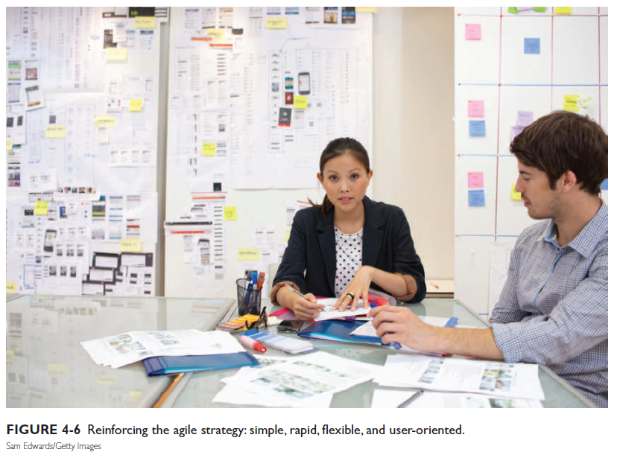
Agile Methods
Attempt to develop a system incrementally
Agilian modeling toolset includes support for many modeling tools
  Some agile developers prefer not to use CASE tools at all, and rely instead on whiteboard displays and arrangements of movable sticky notes.
  This approach, they believe, reinforces the agile strategy: simple, rapid, flexible, and user-oriented.

Slide 23
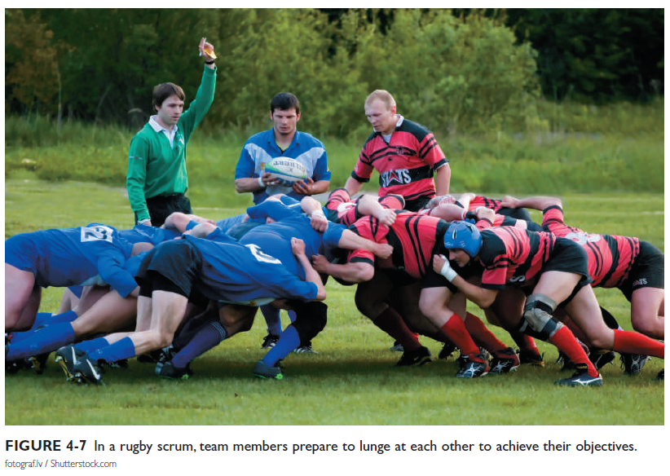
Agile Methods
  Scrum is another agile approach. The name comes from the rugby term scrum, where team members lunge at each other to achieve their objectives, as shown in Figure 4-7.
  The systems development version of Scrum involves the same intense interaction, though it is more mental than physical. In a Scrum session, agile team members play specific roles.

Slide 24
Agile Methods
Agile Method Advantages and Disadvantages
  Are very flexible and efficient in dealing with change
  Frequent deliverables constantly validate the project and reduce risk
  Team members need a high level of technical and interpersonal skills
  May be subject to significant change in scope

Slide 25
Modeling Tools and Techniques
Functional Decomposition Diagrams (FDD)
A functional decomposition diagram (FDD) is a top-down representation of a function or process.
Using an FDD, an analyst can show business functions and break them down into lower-level functions and processes.
Creating an FDD is similar to drawing an organization chart: Start at the top and work downwards.
FDDs can be used at several stages of systems development. During requirements modeling, analysts use FDDs to model business functions and show how they are organized into lower-level processes.
Those processes translate into program modules during application development.

Slide 26
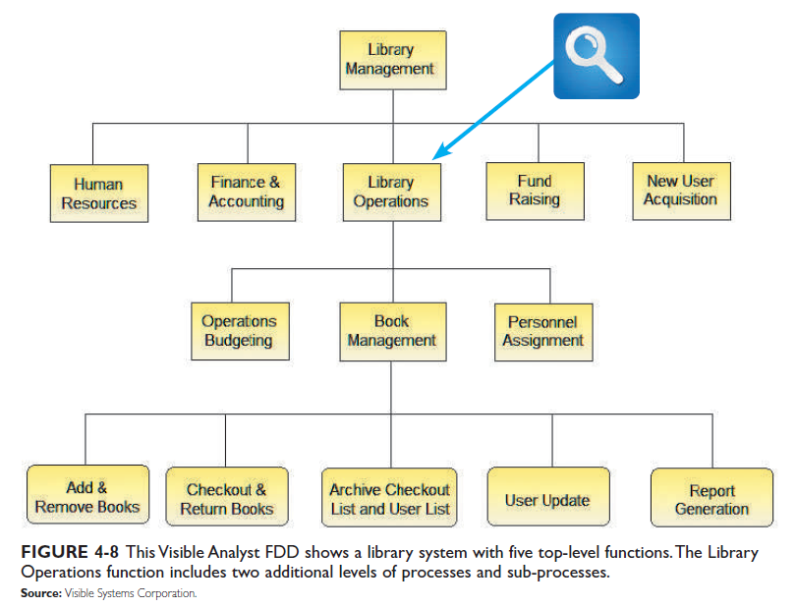
Modeling Tools and Techniques
Functional Decomposition Diagrams (FDD)

Slide 27
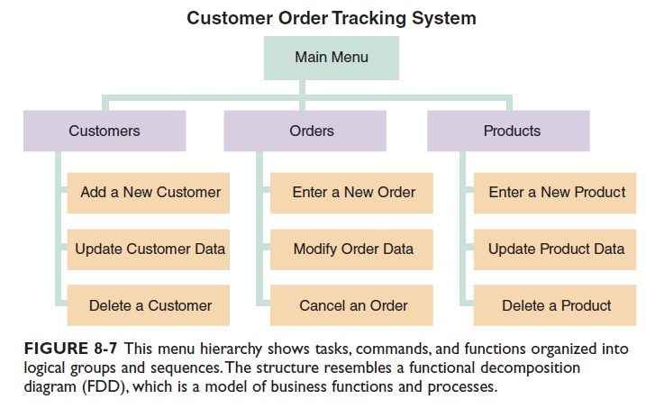
Modeling Tools and Techniques
Functional Decomposition Diagram (FDD)

Slide 28
Esukan boking system
Esukan
ADMIN
USER
EDIT ACC
MANAGE EQUIPMENT
MANAGE ACC
DELETE ACC
ADD ACC
VIEW ACC
ADD
VIEW
EDIT
DELETE
MANAGE BOOKING
ADD
VIEW
EDIT / CHANGE STATUS
DELETE
MANAGE OWN ACC
ADD
VIEW
EDIT
DELETE
EQUIPMENT
VIEW
REQUEST
MANAGE BOOKING
ADD
VIEW
EDIT
DELETE
REPORT

Slide 29
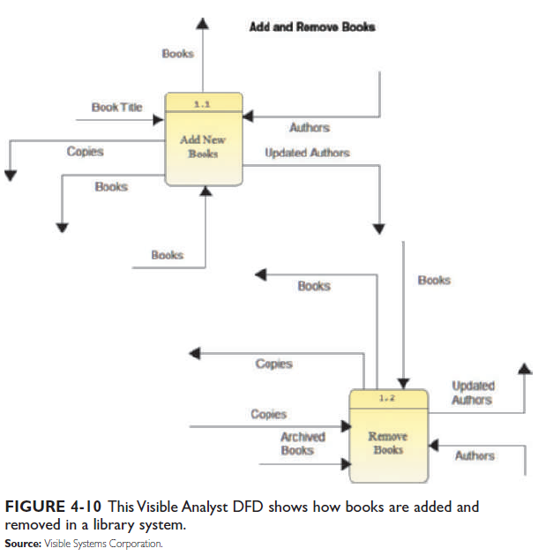
Modeling Tools and Techniques
Data Flow Diagrams (DFD)
Working from a functional decomposition diagram, analysts can create data flow diagrams (DFDs) to show how the system stores, processes, and transforms data.

Slide 30
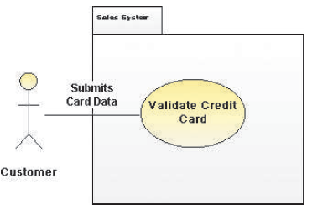
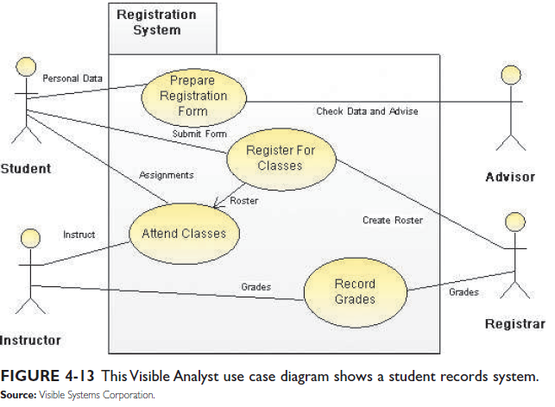
Modeling Tools and Techniques
Unified Modeling Language (UML)
widely used method of visualizing and documenting software systems design. UML uses object-oriented design concepts, but it is independent of any specific programming language and can be used to describe business processes and requirements generally.
UML provides various graphical tools, such as use case diagrams and sequence diagrams.

Slide 31
System Requirements Checklist
During requirements modeling, systems developers must identify and describe all system requirements.
A system requirement is a characteristic or feature that must be included in an information system to satisfy business requirements and be acceptable to users.
System requirements serve as benchmarks to measure the overall acceptability of the finished system.
System requirements fall into five general categories: outputs, inputs, processes, performance, and controls.

Slide 32
System Requirements Checklist
Outputs Examples
  The Web site must report online volume statistics every four hours, and hourly during peak periods
  The inventory system must produce a daily report showing the part number, description, quantity on hand, quantity allocated, quantity available, and unit cost of all sorted by part number
Inputs Examples
  Manufacturing employees must swipe their ID cards into online data collection terminals that record labor costs and calculate production efficiency
  The department head must enter overtime hours on a separate screen

Slide 33
System Requirements Checklist
Processes Examples
  The student records system must calculate the GPA at the end of each semester
  As the final step in year-end processing, the payroll system must update employee salaries, bonuses, and benefits and produce tax data required by the IRS
Performance Examples
  The system must support 25 users online simultaneously
  Response time must not exceed four seconds
Controls Examples
  The system must provide logon security at the operating system level and at the application level
  An employee record must be added, changed, or deleted only by a member of the human resources department

Slide 34
Future Growth, Costs, and Benefits
In addition to the system requirements, systems analysts must consider scalability, which determines how a system will handle future growth and demands, and the total cost of ownership, which includes all future operational and support costs.
Scalability
  A scalable system offers a better return on the initial investment
  To evaluate scalability, you need information about projected future volume for all outputs, inputs, and processes

Slide 35

Future Growth, Costs, and Benefits
Total Cost of Ownership
  Total cost of ownership (TCO) is especially important if the development team is evaluating several alternatives
  One problem is that cost estimates tend to understate indirect costs
  Rapid Economic Justification (REJ)

Slide 36
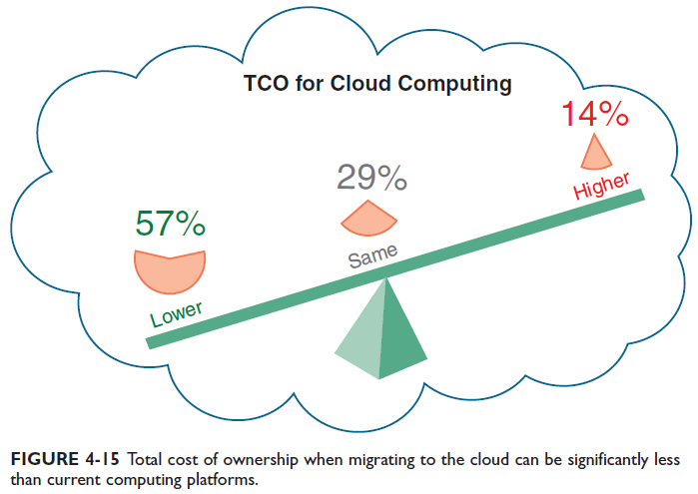
Future Growth, Costs, and Benefits
Total Cost of Ownership
  Because cost control is so important, vendors often claim that their products or services will reduce TCO significantly.
  For example, one of the most common reasons to migrate a legacy system to the cloud is reduced TCO. As shown in Figure 4-15, cloud computing offers the opportunity for lower operational costs due to the outsourcing of expenses such as capital investment in exchange for a pay-as-you-go pricing model.

Slide 37
Fact-Finding
Fact-Finding Overview
  First, you must identify the information you need
  Develop a fact-finding plan
Who, What, Where, When, How, and Why?
  Difference between asking what is being done and what could or should be done

Slide 38
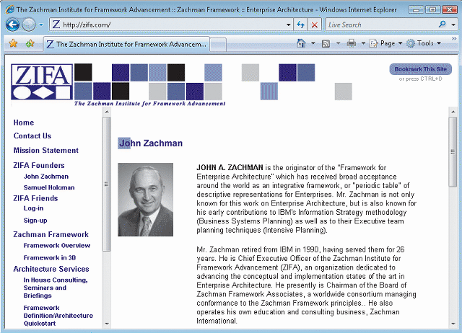
Fact-Finding
The Zachman Framework
  Zachman Framework for Enterprise Architecture
  Helps managers and users understand the model and assures that overall business goals translate into successful IT projects

Slide 39

Interviews
Step 1: Determine the People to Interview
  Informal structures
Step 2: Establish Objectives for the Interview
  Determine the general areas to be discussed
  List the facts you want to gather

Slide 40
Interviews
Step 3: Develop Interview Questions
  Creating a standard list of interview questions helps to keep you on track and avoid unnecessary tangents
  Avoid leading questions
  Open-ended questions
  Closed-ended questions
  Range-of-response questions

Slide 41
Interviews
Step 4: Prepare for the Interview
  Careful preparation is essential because an interview is an important meeting and not just a casual chat
  Limit the interview to no more than one hour
  Send a list of topics
  Ask the interviewee to have samples available

Slide 42
Interviews
Step 5: Conduct the Interview
  Develop a specific plan for the meeting
  Begin by introducing yourself, describing the project, and explaining your interview objectives
  Engaged listening
  Allow the person enough time to think about the question
  After an interview, you should summarize the session and seek a confirmation

Slide 43
Interviews
Step 6: Document the Interview
  Note taking should be kept to a minimum
  After conducting the interview, you must record the information quickly
  After the interview, send memo to the interviewee expressing your appreciation
  Note date, time, location, purpose of the interview, and the main points you discussed so the interviewee has a written summary and can offer additions or corrections

Slide 44
Interviews
Step 7: Evaluate the Interview
  In addition to recording the facts obtained in an interview, try to identify any possible biases
Unsuccessful Interviews
  No matter how well you prepare for interviews, some are not successful

Slide 45

Other Fact-Finding Techniques
Document Review
Observation
  Seeing the system in action gives you additional perspective and a better understanding of the system procedures
  Plan your observations in advance
  Hawthorne Effect

Slide 46
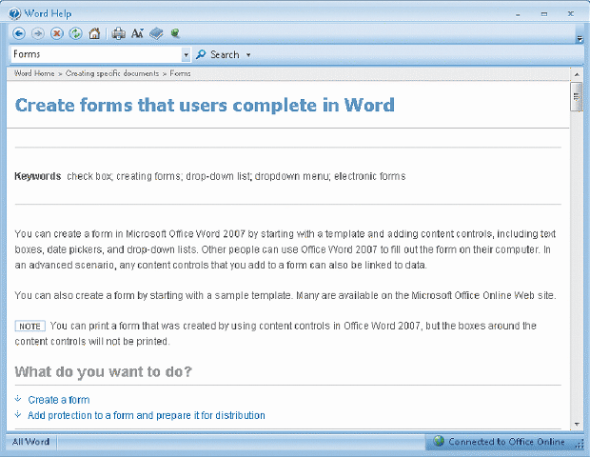
Other Fact-Finding Techniques
Questionnaires and Surveys
  When designing a questionnaire, the most important rule of all is to make sure that your questions collect the right data in a form that you can use to further your fact-finding
  Fill-in form

Slide 47
Other Fact-Finding Techniques
Sampling
  Systematic sample
  Stratified sample
  Random sample
  Main objective of a sample is to ensure that it represents the overall population accurately

Slide 48
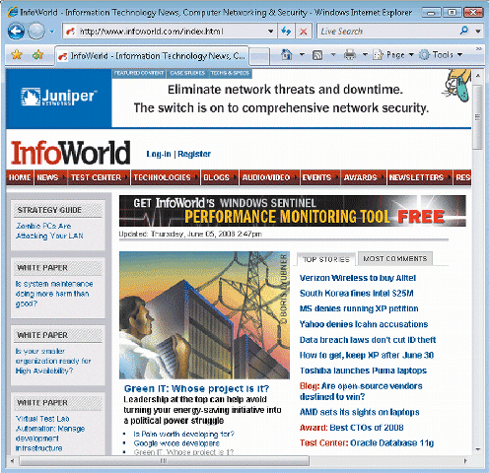
Other Fact-Finding Techniques
Research
  Can include the Internet, IT magazines, and books to obtain background information, technical material, and news about industry trends and developments
  Site visit

Slide 49
Other Fact-Finding Techniques
Interviews versus Questionnaires
  Interview is more familiar and personal
  Questionnaire gives many people the opportunity to provide input and suggestions
  Brainstorming
  Structured brainstorming
  Unstructured brainstorming

Slide 50
Documentation
The Need for Recording the Facts
  Record information as soon as you obtain it
  Use the simplest recording method
  Record your findings in such a way that they can be understood by someone else
  Organize your documentation so related material is located easily

Slide 51
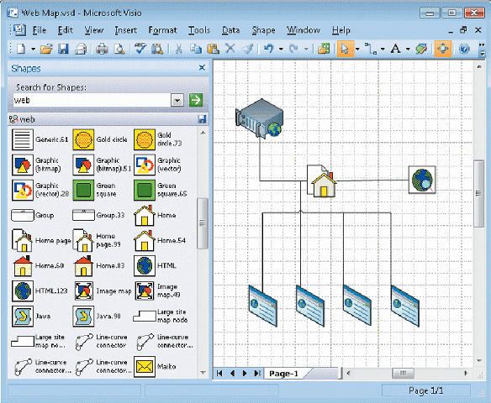
Documentation
Software Tools
  CASE Tools
  Productivity Software
  Graphics modeling software
  Personal information managers
  Wireless communication devices

Slide 52
Preview of Logical Modeling
At the conclusion of requirements modeling, systems developers should have a clear understanding of business processes and system requirements
The next step is to construct a logical model of the system
IT professionals have differing views about systems development methodologies, and no universally accepted approach exists

Slide 53
Chapter Summary
The systems analysis phase includes three activities: requirements modeling, data and process modeling, and consideration of development strategies
The main objective is to understand the proposed project, ensure that it will support business requirements, and build a solid foundation for the systems design phase

Slide 54
Chapter Summary
The fact-finding process includes interviewing, document review, observation, questionnaires, sampling, and research
Systems analysts should carefully record and document factual information as it is collected, and various software tools can help an analyst visualize and describe an information system

Slide 55
Chapter 3: Requirements Modeling
Next Chapter…
Chapter 4: Data & Process Modeling

